Slide 1
Automatic Speech Recognition
Group 2 – Hindi
Faculty Name | Dr. Anil Kumar Vuppala
Mentor | Sai Ganesh Mirishkar
Team Members | Anil Garikipati
 | Gagan Kawde
 | Nav Pallav
Language Chosen : Hindi
Train Data Size : ~29 Hours
Test Data Size : ~10 hours
Dev Data Size : ~3 hours
Facts : Hindi is the most spoken language in India.
Speaking style of Dataset – Read

Slide 2
Contents
Project Overview
Problem Statement
Objectives
Methodologies, Approach and Architecture
Project Status
Inference & Analysis
Demo
Challenges
Comparison to DNN Method
Synopsis

Slide 3
Project Overview
The project involves developing an Automatic speech recognition model for Hindi language.
Automatic speech recognition is the capability of a computer system to decipher spoken words and phrases from audio and transcribe them into written text.
We have chosen the Kaldi toolkit for training the ASR using some hours of transcribed data. Our model will be “Speaker independent” and utilize “Read and Recorded” data for training with limited “Lexicon”.
We are going to adopt HMM (Hidden Markov Model), GMM (Gaussian Mixture Model) and Deep learning models to achieve the Speech-To-Text functionality.

Slide 4
Problem Statement
Industry requires ASR for a broad range of commercial products. Hence, ASR as user interface has become ever more useful and pervasive.
Users can control devices with the help of speech and voice as the audio and text received by such devices automatically gets converted into a machine-friendly format, making it easier for humans to operate devices without having to indulge time and effort by operating other devices such as a mouse, keyboard, and others.
However, reliably recognizing spoken words in realistic acoustic environments is still a challenge. For Indic languages the challenges of wider Phonetics usages, grammar, variations of pronunciation from region to region contribute to complexities of decoding.
Our Project focusses on a deployable model for Speech-text Conversion for Native Indian Languages – Hindi.

Slide 5
Objectives
1) The purpose of this project is to identify model accuracy for Indian language for a selected corpus and type of data.
2) In the process intention is to note various challenges that are encountered with Indian language ASR, such as individual phonetics / style of speech, environmental noises and semantics of the language.
3) Additionally, based on the observed challenges, identify opportunities for overcoming those challenges either by data collection or the way the model can be used.

Slide 6
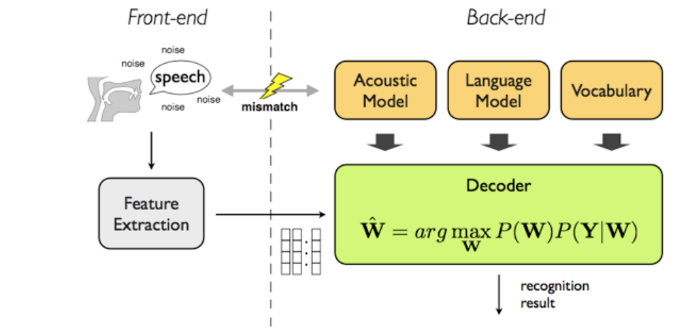
Architecture and Approach
The main blocks of ASR architectures are:
Front-end – for speech recording and storage and output; pre-processing and Feature Extraction
Back-End: for running conversion algorithms and decoding, includes:
Acoustic Model for modelling the relationship between the audio signal and the phonetic units
Recognition Layer models the relationship between audio signal with Language and Lexicons
Decoding Layer provides the most probable Phoneme as output using inputs from Acoustic and Recognition Network

Slide 7
Project Status
Project Stages | High Level Activities | Activities completed | Completion Status | Date Completed
Data Collection/Preparation | Collect the Audio Files | 1. Install required tools and applications – WSL + Kaldi 2. Create folders for data, download and unzip data into the designated folders 3. Create db with two columns for train, test and dev db- 1) <file name> ,2) <text> (content of the audio file) 4.Audio normalization to single format - mp3 to wav as 16khz audio file | Completed | 26th November 2022
 | Pre-processing (Audio/Text)
Model Build/Test | Feature Extraction | 1. Extract one each of mfcc, mono, tri1, tri2 for train and test dataset 2. Train the model Note "Language Model" is ignored | Completed | 11th December 2022
 | Feature Normalization
 | Build/Train the Model
 | Test the Model with the Test Data
 | Blind Test
Deployment |  | Test Model with new User data (Complete) Fast API Backend creation and testing (Complete) - Record and save new audio in defined folder, pre-defined name (wav format , 16KHz) Run model on Audio Recover Decoded text Inference (Complete) Frontend based on HTML (Complete) Integration of backend and Frontend (Complete) | Completed | 11th February 2023
 | REST API
 | HTML Front End
Report | Word and power point submission | Report submission with Inferences Presentation submission | Completed | 18th February 2023

Slide 8
Inferences and Outcomes
Inference construct:
60+ instances of recording and decoding used for inferences, including:
Simple word sentences
Sentences with complex words
Sentences with other regional language words – English, Tamil etc.
Same sentences repeated with more pauses (Individual word/ Isolated word)
Continuous speech (normal rate of speech)
Observations:
Word Success rate at 95.20%, ignoring minor spelling errors
Word Success rate including spelling errors is at ~93%
~65% success rate by sentences, after ignoring minor spelling errors
Long and complex words have ~60% accuracy, while simple sentences have ~70% accuracy
Good pauses between words increases success probability (almost 100% for simple sentences)
Inference Report – Error, causes and improvement journey
Terms | Definition | Observed Causes | Possible Solution
Decoding error | Complete mis-representation of the word or word omitted completely (Substitution or Insertion or Deletion) | Complexity of word | More training with data with variations + Use of better Lexicon based model may reduce error
Decoding error |  | Foreign language word inserted | Bring flexibility in model to accommodate regional language influences: re-training of model based on regional influenced data could open us possibility of accommodating words from other language
Decoding error |  | Speech clarity - Phonetics or acoustic hardware | Limited influence or option to correct
Spelling error | Minor error, however the word is still readable and comprehension is possible | words broken into two words or "Matra" error | Good pauses between words More training with data with variations + Use of Lexicon based model may reduce error

Slide 9
Report & Analysis
The model has provided good performance for simple sentences and isolated word sequences. Performance of sentence types includes utterance of same sentence with various rate of speech, with slow pace and environment playing a role in accuracy of decoding.
Success Rate by Word
Word Error Rate
Complexity Type | Substitution | Deletion | Insertion | Success Percentage
Simple sentence | 19 | 0 | 1 | 96.4%
Foreign Word | 5 | 0 | 0 | 99.1%
Complex Word | 9 | 0 | 0 | 98.4%
Total | 33 | 0 | 1 | 93.95%
Word Error | Error | Total Words | Error Percentage
Substitution | 33 | 542 | 5.9%
Deletion | 0 | 0 | 0.0%
Insertion | 1 | 20 | 0.2%
Total | 34 | 562 | 6.05%
Success Rate w.r.t. Sentences
Types of Sentences/ Total Sentences
Experiment Type Definitions
Experiment Type | Definition | Success Rate
NP | Complex Sentence with normal rate of individual speech | 65.2%
SP | Isolated word or slow rate of individual speech with simple words | 100.0%
FP | Continuous speech with Fast rate of individual speech | 30.0%
Complexity Type | Error | Total | Success Percentage
Simple sentence | 13 | 43 | 69.8%
Foreign Word | 5 | 9 | 44.4%
Complex Word | 5 | 12 | 58.3%

Slide 10
Utterance category wise report
Simple Sentence ~69.8% accuracy
Fast Paced Utterances - ~30% accuracy
Output Sentence | Status | type | Observation
तुम्हारे लिए फुल लेकर | success | NP
तुम्हारा नाम क्या है | success | SP
मैंने अपनी तरफ से सच ही कहा था पर वह तब भी वहां से नहीं गया | success | NP
इतनी भी आसान नौकरी पाकर मेरी खुशी का ठिकाना ना रहा | success | NP
वैसे भी हमारे कमरे में मच्छर होते तो नहीं है | success | NP
आज तो लग रहा है कि सचमुच ही इस कमरे में बहुत मच्छर हो गए हैं | success | NP
विकास मनुष्यों के लिए बहुत जरुरी है | success | NP
कोई मंगलूर ग्रह पर कैसे जाएगा | Error | NP | Mangal changed to mangluru
दोपहर में धूप का रंग सोने जैसा हो जाता है | success | NP
तुम्हारे पास क्या क्या है | success | SP
हमारे पापा का नाम क्या है | success | SP
नयी मूवी का नाम क्या | success | SP
Output Sentence | Status | type | Observation
आज सोमवार का दिन है और फर्वरी का दूसरा देन है | success | FP
आज रविवार है कल शनिवार था पर सौ शुक्रवार था आज की तारीख पांच फरवरी दोहजार तेईस है कल छे तारीख सोमवार होगा उसके" | success | FP
फिर भी यह सच है कि कथा काफी की रचनाओं आदि से अंत तक केवल दयनीय हाथ के भरोसे नहीं की जा सकती | Error | FP
उसके सामने बहुत संभावना बगीचे भी लगाया है | Error | FP
शाम को जब दिन की गर्मी ढाल जाती है और आसमान की रंग के हो जाते हैं | Error | FP
Complex Word Sentences ~58.3% accuracy
Foreign Word Sentences ~44.4% accuracy
Output Sentence | Status | type | Observation
पड़ना लिखना एक समग्र सार्थक और निरंतर चलने वाली प्रक्रिया है | success | FP
इस तरह सीधे काबिल को भी किसी भूमिका की जरूरत है ऐसा बयान नहीं मानता | Error | FP | Saral, Kavya, Main
मगर कुछ न लिखें तो वे पाठक पुजारा उतारू हो जाएंगे | Error | FP | Udas
जो मूल पुस्तक के पढ़ने में हाथ लगाने से पूर्व किसी न किसी पूर्वा भाषा | success | NP
वो भी हर चीज का कुछ ना कुछ इतिहास होता है | success | NP
बात यह है कि कृषि क्षेत्र की रचनाकर चुकाने के बाद ही मुझ में जब भाव जगह कि | Spelling | FP | KuruKshetra,
इस कविताओं में जिन व्यावहारिक के नाम आए हैं वे भारत में कहा और किस प्रकार बनाए जाते हैं | Error | FP | Tyohar converted to Vyavaharik
Output Sentence | Status | Type | Observation
पोन्गल का त्योहार रही महीने में आता है | Error | NP | Tai
भी होगी के दिन लोग घर की सफाई करते है | Error | NP | Bhogi
कौन नई फसल के चावल से बनाते | Error | NP | Bhogi
आज खाने मे पढ़ी है | Error | NP | Friday
सहारा परिवार डोमिनर के लिए बाहर गया था | Error | NP | Dinner
रमेश मूवी देखने गया था | success | NP
तुम बिल्कुल भी टेंशन मत लोग | success | NP

Slide 11
DEMO
Group 2: Automatic Speech Recognition – Hindi

Slide 12
Challenges
While this exercise was limited in scope and nature, the challenges faced during this exercise can be extended for other broader implementation challenges for ASR. Some of the challenges observed during ASR exercise are:
Data availability: Limited data availability in native languages/ Indic languages due to lack of available transcribed resources compared to English
Foreign Word Codemix: Usage or borrowing of other language words is common in practice, which creates it’s own sets of challenges
Grammar and vocabulary of Indic language has variations from region to region
Overfitting Problem: Training data is often sanitized and standardized while actual usage language includes lot of noise, variations (individual style, rate of speed, individual clarity of certain phonetics, environment etc.)
Lexicon: Indic languages have the maximum number of alphabets and combinations possible, using an exhaustive Lexicon is crucial for success, while the English letter based Lexicon will not cover the required Indic Language Lexicon.

Slide 13
Comparison with other approaches
We have compared our ASR approach to a “Bootstrapping Acoustic Models” using DNN by Microsoft Hyderabad Team. The actual conference document can be found at - https://ieeexplore.ieee.org/document/8077100/authors#authors
Comparison Report: GMM (Gaussian Mixture Model) and DNN (Deep Neural Networks) are two ways to classify every frame in the speech, they both could be used together with HMM model and Viterbi algorithm to decode frame sequencies.
Observations:
GMM is faster to compute, easier to learn.
DNNs are more accurate classifiers.
DNN is very slow to train compared to GMM, they usually require GPU or lots of CPUs.
Conclusion on the comparison: The real nature of speech in neither Gaussian nor Markovian. Thus, GMMHMM is just an approximation to make the model traceable and solvable. Today, with enough supervised data available, the progress of DNN including CTC, GPU hardware for optimization, etc. one can use the power of NN to train a discriminative model rather than a generative one. Moreover, NN where should to be a general function approximation thus are not limited by bias (if the number of units are unlimited).
Field | IIIT H Group2 Experiment | Microsoft Hyderabad Team Experiment
Scope | Monolingual trained model for Hindi read data | Bootstrapped multi-lingual, extending standard English phone set by including the extra phones present in Hindi
Approach | HMM GMM | CD-DNN-HMM model
 | Linear discriminant analysis (LDA) | Singular Value Decomposition
 | Limited Lexicon (12078) | Exhaustive Lexicon
Data used | 30 Hours | 2200 hours

Slide 14
Synopsis
From a Machine Learning perspective, ASR is also really hard due to very high dimensional output space, and a complex sequence to sequence problem. The accuracy is also based on various experimentation with rate of speech alterations, complex word insertions (sandhi – samas) and insertion of other language words in the sentence.
While DNNs are more accurate, the limitations of available computational resources can restrict it’s usage in small scale experiments.
We have identified activities to enhance the accuracy of the model through:
More exposure to datasets
Including regional variation (spoken dialect) of the same language in the data
Expanding the Lexicon exposure of the model
The current model is a good candidate of command based usage of ASR (Home-Automation) and after improvement it may be utilized for translation usage.

Slide 15
Thankyou

Slide 16
References
https://www.atco2.org/news/automatic-speech-recognition-how-it-works --> slide with methodologies
https://www.prnewswire.com/in/news-releases/speech-and-voice-recognition-market-to-rise-exponentially-at-a-cagr-of-19-8-cloud-based-segment-to-emerge-dominant-says-fortune-business-insights-828795577.html
https://www.esat.kuleuven.be/psi/spraak/theses/08-09-en/MDT.php
https://www.atco2.org/news/automatic-speech-recognition-how-it-works
https://maelfabien.github.io/machinelearning/speech_reco/#feature-extraction-x

Slide 17
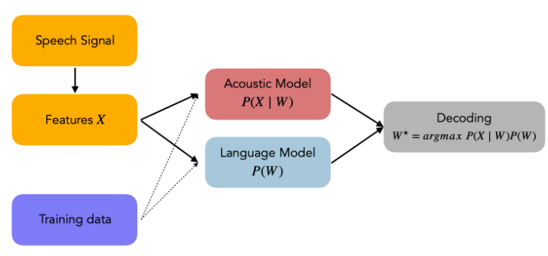
ASR Methodology
In automatic speech recognition, you do not train an Artificial Neural Network to make predictions on a set of 50’000 classes, each of them representing a word.
Instead, an input sequence is taken and an output sequence is produced. Each word is represented as a phoneme or sequence of phonemes.
The ASR model takes the speech, extracts relevant features in small chunks, matches it with acoustic and language model to provide a probable phoneme for that extract. The sequence of these output is then sequenced to form word/s.

Slide 18
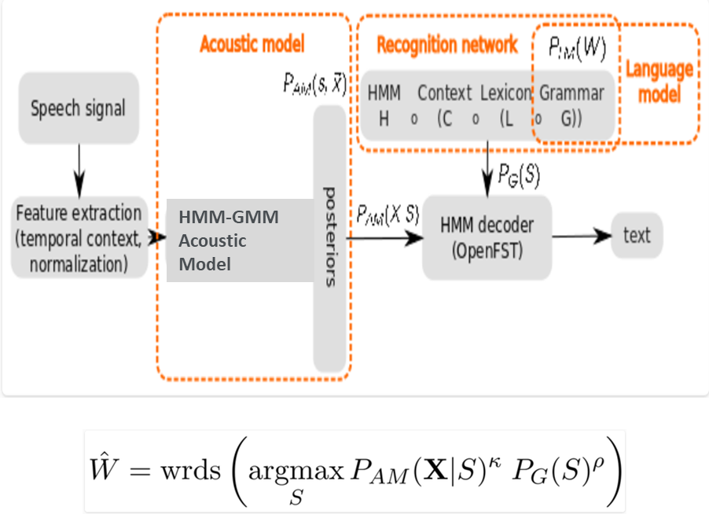

Mathematical Formulation
Let us denote the optimal word sequence W⋆ from the vocabulary. Let the input sequence of acoustic features be X.
Statistically, our aim is to identify the optimal sequence such that: W⋆=argmaxWP(W∣X)
This is known as the “Fundamental Equation of Statistical Speech Processing”. Using Bayes Rule, we can rewrite is as: W⋆=argmaxWP(X∣W)P(W)P(X)
Finally, we suppose independence and remove the term P(X). Hence, we can re-formulate our problem as: W⋆=argmaxWP(X∣W)P(W)
Where: argmaxW is the search space, a function of the vocabulary, P(X∣W) is called the acoustic model, P(W) is called the language model.

